Slide 1
Emotional Analysis and Evaluation of Positive and Negative Aspects Based on
Comprehensive Quality Evaluation
in Tsinghua University High School
Date: 05/23/2019
Presenter: Zhaoyang Tian

Slide 2
Agenda
1
Introduction
2
Data Extraction
3
JIEBA Word Segmentation
4
WORDCLOUD
5
Emotional Evaluation
6
Supporting Vector Machine
7
Evaluation of Positive and Negative Aspects
8
Conclusion

Slide 3
Introduction

Slide 4

Introduction

Slide 5
Introduction
Transforming the enrollment system to comprehensive-quality-oriented
Concentrated on the all-round developments of students rather than their test scores
Students can voluntarily upload the photos and text description and reveal their special activities and strength that cannot be reflected in class or by scores.

Slide 6
Introduction
Achievements
Design and purpose of CQE
Ideas of Student Assessment system
Limitations
Small amount of data
Specific Experiment
A elaborate technique to analyze students' interest
My research

Slide 7
Introduction
To demonstrate the data set in a brand new manner.
To evaluate the positive and negative feelings behind the data.
To judge the most popular and welcomed activities among school students.
To evaluate the positive and negative aspect of the popular activities.

Slide 8
Introduction
End
Beginning
Conclusion
JIEBA Segmentation
Supporting Vector Machine
Word Frequency Analysis
SnowNLP
Original Emotional Analysis
WORDCLOUD

Slide 9
Data Extraction

Slide 10
Data Extraction
Data in the CQE system of grade G17(senior 2 in 2018-2019 academic year) in Tsinghua University High School from February, 2018 to June, 2018
6 dimensions to study, which are PE Practices(体育类实践活动), Innovative Achievement(创新成果), Excursion Experiences(游学经历), Club Events(社团活动), Artistic Achievements(艺术成果展示), and Artistic Practices(艺术类实践活动)

Slide 11
JIEBA Word Segmentation

Slide 12
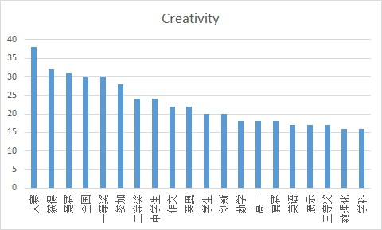
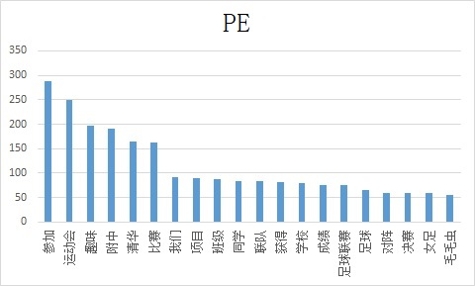
JIEBA Word Segmentation
Divide sentences into separate words
Word frequency analysis with stopwords

Slide 13
WORDCLOUD

Slide 14
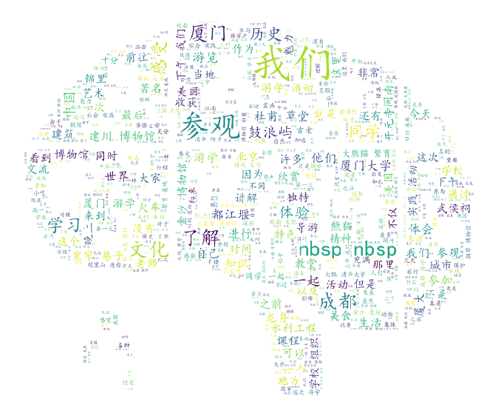
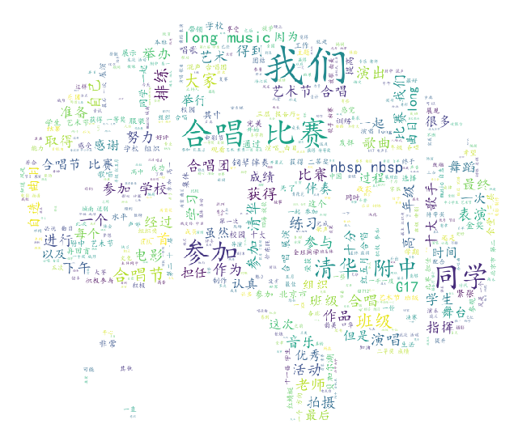
JIEBA Word Segmentation
With the aid of WORDCLOUD module
Generates wordclouds through set of parameters

Slide 15
Emotional Evaluation

Slide 16
Emotional Analysis
End
Number of reverse words
Beginning
Cross-test
Number of exclamation marks
Enumeration of word lists
Score of a paragraph
Weight
Preparation of the data
Number of Degree words
4
Score of a single sentence
2
Number of Negative words
0.5
Number of Positive words

Slide 17
Supporting Vector Machine

Slide 18
Supporting Vector Machine
华侨大学 | 15
大熊猫 | 25
四川 | 20
川剧 | 15
变脸 | 11
辩论 | 20
模联 | 34
艺术节 | 12
明哲 | 7
李宁杯 | 7
电影 | 13
电视台 | 6
合唱节 | 16
艺术节 | 18
合唱 | 198
运动会 | 249
足球 | 66
篮球 | 31
数理化 | 16
创新英语 | 17
高研 | 13
力学 | 13
厦门 | 84
成都 | 79
都江堰 | 36
武侯祠 | 34
龙舟 | 31
草堂 | 27
宽窄 | 23
To extract keywords of the activities

Slide 19
Evaluation of Positive
and Negative Aspects

Slide 20
Evaluation of Positive and Negative Aspects
Search the pieces of data that contains the fields of the names of hot activities
Find the positive and negative aspects of the activities manually

Slide 21
Conclusion

Slide 22
Conclusion
“Nervous”(紧张) : treated as negative in sports activities
Too less words in a piece of data: a negative one
“Visit”(参观), “observe”(观察): negative/ “participate”(参加), “involvement”(体验): positive
Data related to innovative achievements, excursion experience, club events are very likely to be viewed as positive.
A piece of descriptive data is more likely to be positive than a piece of narrative data.

Slide 23

[1] https://gzzp.bjedu.cn, Comprehensive Quality Evaluation Platform for Beijing General High School Students [EB/OL].
[2] Ze L., Reflections on the Evaluation of Comprehensive Quality in the Reform of College Entrance Examination [J], Contemporary Educational Science, 2017(4): 32-36, 45.
[3] Bingbing X., From Comprehensive Quality Assessment to Key Competencies Assessment----Research on the Transition of Student Assessment in High School [D]. Shanghai, China: East China Normal University, 2016.
[4] Zhaohui C., Study on Implementation of Senior High School students' Comprehensive Quality Assessment [D]. Zhengzhou, China: Henan University, 2016.
Bibliography

Slide 24
[5] Huoyun C. Zheng K., Research on Comprehensive Quality Evaluation of Senior High School Students [J], Global Education, 2010(9): 3-8,12.
[6] Jing W. Xi J. Dong L., Evaluation of Students’ Comprehensive Quality with the Aim of Promoting Development—The Concept and Practice of the Construction of the Second Class Transcript [J], Learning Resource and Technology, 2018(9).
[7] Xiaoming W. Nianjin D., History and Evolution of Ten Years Reform of the Comprehensive Quality Evaluation of Students in General Senior High School [J], Modern Education and Management, 2015(11): 74-79.
[8] Zhijun L. Hongxia Z., Evaluation on Senior High School Students Comprehensive Quality: Reality, Problem and Prospect [J], Curriculum, Teaching Material and Method, 33(1): 18-23.
[9] Long C., The Difficulty and Breakthrough of "Hard Link" between Comprehensive Quality Evaluation and College Enrollment [J], Journal of The Chinese Society of Education, 2017(7): 19-23.
[10] Dianjun W. Hui J. Weidong Meng. The High School Attached to Tsinghua University, Development and Application of the Comprehensive Student Quality Evaluation System Based on Big Data: Innovative Practice of the High School Attached to Tsinghua University [J], Chinese Examinations, 2018(1): 46-52, 66.
[11] https://blog.csdn.net/daniel\_ustc/article/details/48195287, Source Code Analysis of Chinese Word Segmentation in JIEBA Module [EB/OL].
[12] https://www.cnblogs.com/bymo/p/9334981.html, Keyword extraction based on WORDCLOUD Module: The use of wordcloud, source code analysis, generation of Chinese word cloud, and code rewriting [EB/OL].
[13] https://blog.csdn.net/google19890102/article/details/80091502, Emotional Analysis----Deepening the Principle and Practice of SnowNLP [EB/OL].
[14] https://blog.csdn.net/jzy3711/article/details/84760981, Positive and Negative Emotional Words [EB/OL].
[15] https://blog.csdn.net/qq\_16953611/article/details/82414129, Sklearn----SVM [EB/OL].
[16] Haiwei W. Yu X. Yalin W. A bivariate hierarchical Bayesian approach to predicting customer purchase behavior [J], Journal of Harbin Engineering University, 2007, 28(8): 949-954.

Slide 25
Thanks for your listening
Date: 05/23/2019
Presenter: Zhaoyang Tian

